Slide 1
Polarion Implementation Project
Requirements Management Module
Equipment and software only projects
August 2022

Slide 2
What has changed from Siemens maturity review?
All report configuration changed to match Vision templates.
All work item definition changed to match Vision data structure.
All label names changed to match Vision terminology.
Summary
The Polarion configuration is changed to match Vision processes.

Slide 3
Outline
Fundamentals 5-10 min
Polarion data objects
High level process definition
Surgical Vision deliverables vs Polarion Data model 20-30 min
Surgical Vision deliverables → Polarion data model
Discussion on Polarion deliverables
User interaction with Polarion 30-40 min
Demo- “How to use Polarion to generate the JJSV deliverables?”
Validation
Approach for Vision configuration
Functional specification
User Acceptance Testing…

Slide 4
Fundamentals

Slide 5
What is work item? Why is it used?
Work Items represent various artifacts - for example requirements, tasks, change requests. Each artifact type is represented in Polarion by a Work Item type defined in the global configuration, the project configuration, or both.
Each work item has multiple fields for user input, such as,
Author
Title
Description
Project
Approval status
Etc...
All the data referenced in the PRTM, FMEAs or Risk Assessments are stored in Work Items.

Slide 6
Document vs Report
 | Document | Report
Definition | Documents (or LiveDocs) are document-like containers for both free-form text and granular Work Items. (think MS Word) | Report Page (or LiveReport) are custom-built layouts for a report with charts that retrieve, aggregate, and/or format Work Item and other project data.
OOTB Redlining feature | Document has OOTB redlining feature. | LiveReports do not have OOTB redlining feature.
Traceability tables and data tables | Document do not support traceability matrices. | Report can be custom built to support traceability matrices
Use | All banner pages are configured using Documents. | All traceability matrices and data tables are custom built using LiveReports.

Slide 7
Process definition
User input
Polarion generated outputs
DHF deliverable as pdf export
Banner page
Codeless LiveDoc
(Polarion word editor)
LiveDoc or Document
Graphical user interface
(or)
Codeful
LiveReport or Report
Data as attachment
Import in bulk
(or)
Codeful report
(Polarion spreadsheet)

Slide 8
Surgical Vision configuration:
Architecture and data model

Slide 9
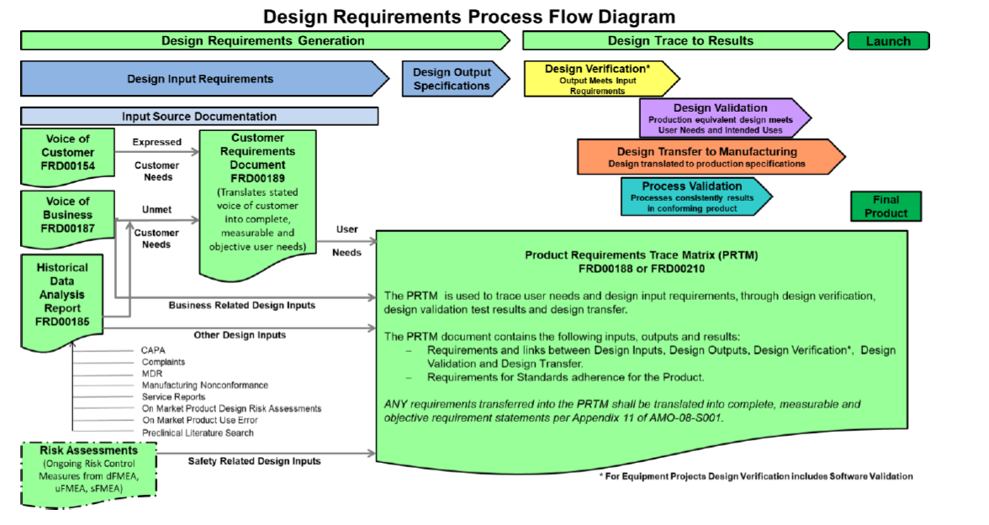
Surgical Vision deliverables mapped to Polarion Work Items
Verification Test Case
Design Output Specification
Verification Test Case
VOC
System Requirement
Design Transfer
VOB
User Need
HDA
System Requirement
Input Source
Key takeaway
The data model has a unique location for all Surgical Vision deliverables.

Slide 10
Surgical Vision deliverables mapped to Polarion Work Items
Voice of Customer
Is summarized by
Voice of Customer
Is derived by
User Need
Is validated by
Validation Test Case
Is derived by
Voice of Business
Is refined by
Is verified by
Is derived by
System Requirement
Verification Test Case
Historical Data Analysis
Is verified by
Is implemented / refined by
Risk Control
Subsystem Requirement
Is realized by
Is realized by
Design Output Specification
Key takeaway
The data model configured to match Surgical Vision processes and deliverables.

Slide 11
Polarion Deliverables:
Surgical Vision reports

Slide 12
Polarion Deliverables for Surgical Vision- Equipment
Surgical Vision- Template Title, number and revision | Polarion file name | Location in the Polarion project
PRTM Equipment FRD00210 Rev 04 | PRTM Equipment and software projects-FRD00210-rev04-Banner-Page | TBD
 | PRTM Equipment and software projects-FRD00210-rev04-EDITABLE-REPORT | TBD
 | PRTM Equipment and software projects-FRD00210-rev04-PDF-EXPORT-REPORT | TBD
 | PRTM Equipment and software projects-FRD00210-rev04-REDLINE-REPORT Not yet configured | TBD
Description | Example use cases
 | DOORs Output (Reference DHF1688-2001) | Polarion Output
Polarion configuration provides better traceability. | No tractability to unique identifiers in VOC, VOB and HDA deliverables. | Requirements are traced to unique identifiers in VOC, VOB and HDA deliverables.
Polarion configuration is validated. | Same unique identifier is used for different data points. Blanks cells found in approved PRTM. Data in cells truncated in approved PRTM. | Not applicable. Polarion configuration will be a validated.

Slide 13
Polarion Deliverables for Surgical Vision- Equipment
Surgical Vision- Template Title, number and revision | Polarion report name | Location in the Polarion project
Voice Of Customer FRD00154 Rev05 | Voice Of Customer-FRD00154-rev05-Banner-Page | TBD
 | Voice Of Customer-FRD00154-rev05-EDIT-REPORT Not yet configured. On-hold pending feedback. | TBD
 | Voice Of Customer-FRD00154-rev05-PDF-EXPORT-REPORT | TBD
 | Voice Of Customer-FRD00154-rev05-REDLINE-REPORT Not yet configured | TBD
Description | Example use cases
 | DOORs Output | Polarion Output
Polarion configuration provides better traceability. | Not configured in DOORs | Configured in DOORs

Slide 14
Polarion Deliverables for Surgical Vision- Equipment
Surgical Vision- Template Title, number and revision | Polarion report name | Location in the Polarion project
Voice Of Business FRD00187 Rev04 | Voice Of Business-FRD00187-rev04-Banner-Page | TBD
 | Voice Of Business-FRD00187-rev04-EDIT-REPORT Not yet configured. On-hold pending feedback. | TBD
 | Voice Of Business-FRD00187-rev04-PDF-EXPORT-REPORT | TBD
 | Voice Of Business-FRD00187-rev04-REDLINE-REPORT Not yet configured | TBD
Description | Example use cases
 | DOORs Output | Polarion Output
Polarion configuration provides better traceability. | Not configured in DOORs | Configured in DOORs

Slide 15
Polarion Deliverables for Surgical Vision- Equipment
Surgical Vision- Template Title, number and revision | Polarion report name | Location in the Polarion project
Historical Data Analysis FRD00185 Rev03 | Historical Data Analysis -FRD00185-rev03-Banner-Page | TBD
 | Historical Data Analysis -FRD00185-rev03-EDIT-REPORT Not yet configured. On-hold pending feedback. | TBD
 | Historical Data Analysis -FRD00185-rev03-PDF-EXPORT-REPORT | TBD
 | Historical Data Analysis -FRD00185-rev03-REDLINE-REPORT Not yet configured | TBD
Description | Example use cases
 | DOORs Output | Polarion Output
Polarion configuration provides better traceability. | Not configured in DOORs | Configured in DOORs

Slide 16
Polarion Deliverables for Surgical Vision- Equipment
Surgical Vision- Template Title, number and revision | Polarion report name | Location in the Polarion project
Customer Requirements Document FRD0018 Rev04 | Customer Requirements Document-FRD0018-Rev04-Banner-Page | TBD
 | Customer Requirements Document-FRD0018-Rev04-EDIT-REPORT Not yet configured. On-hold pending feedback. | TBD
 | Customer Requirements Document-FRD0018-Rev04-PDF-EXPORT-REPORT | TBD
 | Customer Requirements Document-FRD0018-Rev04-REDLINE-REPORT Not yet configured | TBD
Description | Example use cases
 | DOORs Output | Polarion Output
Polarion configuration provides better traceability. | Not configured in DOORs | Configured in DOORs

Slide 17
Polarion Deliverables for Surgical Vision- Equipment
Surgical Vision- Template Title, number and revision | Polarion report name | Location in the Polarion project
System Requirements Document EQP-08-T102 Rev-02 | System Requirements Document-EQP-08-T102-Rev-02-Banner-Page | TBD
 | System Requirements Document-EQP-08-T102-Rev-02-EDIT-REPORT Not yet configured. On-hold pending feedback. | TBD
 | System Requirements Document-EQP-08-T102-Rev-02-PDF-EXPORT-REPORT | TBD
 | System Requirements Document-EQP-08-T102-Rev-02-REDLINE-REPORT Not yet configured | TBD
Description | Example use cases
 | DOORs Output | Polarion Output
Polarion configuration provides better traceability. | No tractability to unique identifiers in VOC, VOB and HDA deliverables. | Requirements are traced to unique identifiers in VOC, VOB and HDA deliverables.
Polarion configuration is validated. | Same unique identifier is used for different data points. Blanks cells found in approved PRTM. Data in cells truncated in approved PRTM. | Not applicable. Polarion configuration will be a validated.

Slide 18
Polarion Deliverables for Surgical Vision- Equipment
Surgical Vision- Template Title, number and revision | Polarion report name | Location in the Polarion project
Hardware Subsystem Requirements EQP-08-T104 Rev 02 | Hardware Subsystem Requirements-EQP-08-T104-Rev 02-Banner-Page | TBD
 | Hardware Subsystem Requirements-EQP-08-T104-Rev 02-EDIT-REPORT Not yet configured. On-hold pending feedback. | TBD
 | Hardware Subsystem Requirements-EQP-08-T104-Rev 02-PDF-EXPORT-REPORT | TBD
 | Hardware Subsystem Requirements-EQP-08-T104-Rev 02-REDLINE-REPORT Not yet configured | TBD
Description | Example use cases
 | DOORs Output | Polarion Output
Polarion configuration provides better traceability. | No tractability to unique identifiers in VOC, VOB and HDA deliverables. | Requirements are traced to unique identifiers in VOC, VOB and HDA deliverables.
Polarion configuration is validated. | Same unique identifier is used for different data points. Blanks cells found in approved PRTM. Data in cells truncated in approved PRTM. | Not applicable. Polarion configuration will be a validated.

Slide 19
Polarion Deliverables for Surgical Vision- Equipment
Surgical Vision- Template Title, number and revision | Polarion report name | Location in the Polarion project
Software subsystem Requirements EQP-08-T201 Rev 02 | Software subsystem Requirements-EQP-08-T201-Rev 02-Banner-Page | TBD
 | Software subsystem Requirements-EQP-08-T201-Rev 02-EDIT-REPORT Not yet configured. On-hold pending feedback. | TBD
 | Software subsystem Requirements-EQP-08-T201-Rev 02-PDF-EXPORT-REPORT | TBD
 | Software subsystem Requirements-EQP-08-T201-Rev 02-REDLINE-REPORT Not yet configured | TBD
Description | Example use cases
 | DOORs Output | Polarion Output
Polarion configuration provides better traceability. | No tractability to unique identifiers in VOC, VOB and HDA deliverables. | Requirements are traced to unique identifiers in VOC, VOB and HDA deliverables.
Polarion configuration is validated. | Same unique identifier is used for different data points. Blanks cells found in approved PRTM. Data in cells truncated in approved PRTM. | Not applicable. Polarion configuration will be a validated.

Slide 20
Polarion Deliverables for Surgical Vision- Equipment
Deliverable | Status | Comments
Design output specification | Deliverable will not be generated inside the Polarion system. As per current process- Deliverable will be generated offline using MS Word. Deliverable routed in PLM for approval. Deliverable unique identifier is entered into Polarion. | Benchmarked against DOORs
Design verification protocol and reports | First iteration of the configuration complete. Polarion team member to travel to Milpitas, conduct the workshop and finalize the requirements for Test Management. | Not applicable
Design validation protocol and reports

Slide 21
Process definition

Slide 22
Process definition
User input
Polarion generated outputs
DHF deliverable
Banner page
Codeless LiveDoc
(Polarion word editor)
LiveDoc or Document
Graphical user interface
(or)
Codeful
LiveReport or Report
Data as attachment
Direct bulk import
(or)
Codeful report
(Polarion spreadsheet)

Slide 23
Creation of Banner page
Create
Create document using pre-configured templates
Edit the document
Save
Save the document
Export
Export pdf and redline version
Edit
Demo-VOC
The templates in the Polarion system are maintained current by the Polarion Project team.

Slide 24
Creation of report page
Import
Import legacy work items with links in bulk
Edit
Edit work items and links
Create
Create new work items and links
Export
Export pdf and redline version
Approve
Approve work items
The reports are configured and maintained by the Polarion Project team.
The approval process is a ‘nudge’ to minimize user errors.

Slide 25
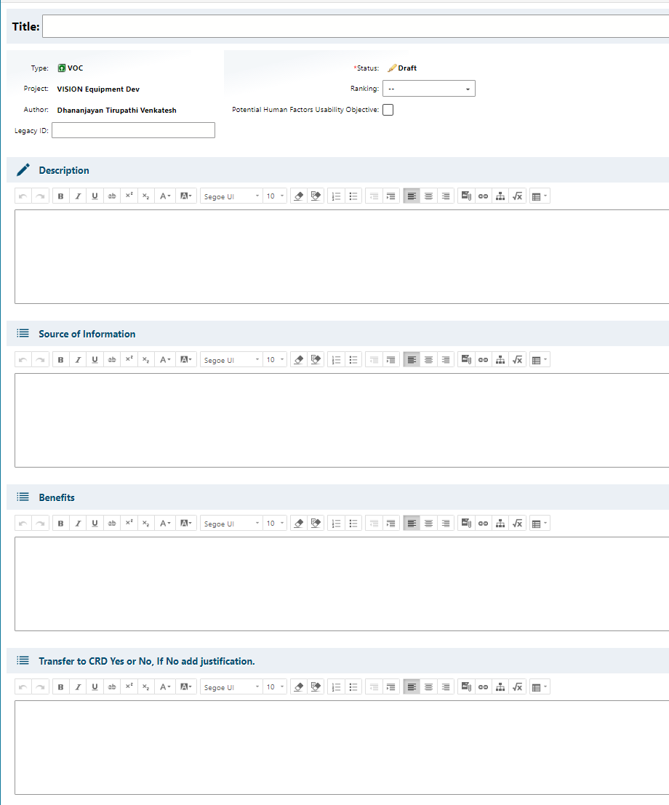
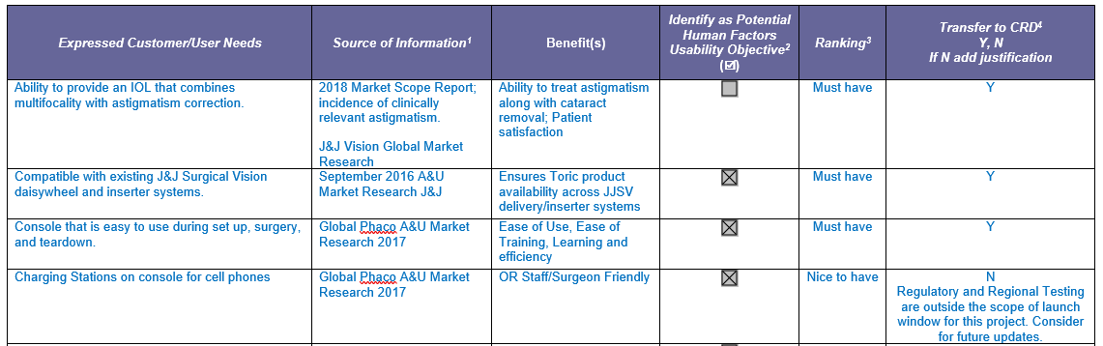
Work Item definition- Example VOC
User experience objectives
Give what they want.
User must not have to think.
Approach
Mimic the Surgical Vision process/templates as-is.
Polarion Screenshot
JJSV Template Screenshot

Slide 26
Creation of PRTM
Import / Create
VOB
Design Output Specification
Product Requirements Trace Matrix
VOC
System Requirement
Output
Demo-PRTM
Subsystem Requirement
Validation protocol/plan/report
HDA
Verification protocol/plan/report

Slide 27
Polarion process- Tentative transition plan
Until Dec 2023
Polarion Project admin to create the Polarion project
2024 and beyond
Polarion Project admin to create the Polarion project
Project users create, edit and modify project data
NPD Project team identifies users for the Project.
TCS team upload legacy data
NPD Project team identifies atleast one project owner
NPD Project team identifies users for the Project.
NPD Project team identifies atleast one project owner
Project users upload legacy data
Project users create, edit and modify project data
Training provided by Polarion Project team
In-person training
Video conference
ComplainceWire
Training videos

Slide 28
Validation
Notes:
This section should be left as is for now, TBD

Slide 29
Validation approach
IT validation
VISION specific customization validation
Total Validation package
Completed by Dave and Siemens Team.
Scope include but not limited to-
Server data back up
Disaster recovery processes/ requirements
Security management login testing/security breach etc.
Completed by Danny and TCS Team.
Scope include but not limited to-
Work items fields
Reports
Banner page set-up
QMS Procedures/Work instructions/training
User Acceptance Testing

Slide 30
Server Architecture
JJSV Equipment and software only
Master JJSV- Equipment and software only
Project 1
Project 2
JJSV implantable
Master JJSV implantable
JJVC CEH
Project 1
JJVC Contact lens
Project 1
Project 2
Master JJVC CEH
Project 2
Master JJVC Contact lens
Project 1
Project 2
Maintained by VISION Project admin
Maintained by VISION Project admin
Maintained by Vision Project teams

Slide 31
Work item and fields map- FRD000210 Rev 04
FRD000210 headers | # | provide Input source | user NEED from CRD or DEsign requirement | DESIGN Input Requirement | Subsystem requirement specification (Lower level SYS/HW/SW)¹ | DESIGN OUTPUT Specification (Acceptance Criteria) | IS DESIGN OUTput a CQA/ESSENTIAL REQUIREMENT FOR PROPER FUNCTIONING OF THE DEVICE? (Y/N)² | DESIGN VERIFICATION (FOr DESIGN INPUT REQUIREMENTS) | DESIGN VALIDATION (For User Needs) | DESIGN TRANSFER
Polarion report headers | Not applicable | provide Input source | user NEED from CRD or DEsign requirement | DESIGN Input Requirement | Subsystem requirement specification (Lower level SYS/HW/SW)¹ | DESIGN OUTPUT Specification (Acceptance Criteria) | IS DESIGN OUTput a CQA/ESSENTIAL REQUIREMENT FOR PROPER FUNCTIONING OF THE DEVICE? (Y/N)² | DESIGN VERIFICATION (FOr DESIGN INPUT REQUIREMENTS) | DESIGN VALIDATION (For User Needs) | DESIGN TRANSFER
Work Item type | Not applicable | System Requirement <and> Input source Unique identifier | User need <or> System Requirement | System Requirement | Subsystem requirement | Design output Specification | Design output Specification | Verification Test case | Validation Test case | System Requirement
Work Item field | Not applicable | INPUT SOURCE | Description | Description | Description | Description | IS DESIGN OUTPUT A CQA/ESSENTIAL REQUIREMENT FOR PROPER FUNCTIONING OF THE DEVICE? | Description | Description | DESIGN TRANSFER
Field data type | Not applicable | User select- Drop down | User entry-Rich text | User entry-Rich text | User entry-Rich text | User entry-Rich text | User select- Boolean | User entry-Rich text | User entry-Rich text | User select- Drop down

Slide 32
Exception handling- General
Description | Edit report | Read only report (used for export to PLM)
User does not approve Work Item. | Work item displayed with status as “work item not approved”. | Work item is not displayed.
User does not link a one Work item in a particular row. Exception:- sub-system requirement WI | The following text is displayed “TBD. No Work Item linked”. | The following text is displayed “TBD. No Work Item linked”.
User links the Work item but leaves the applicable field blank. | The following text is displayed “Field is blank”. | The following text is displayed “Field is blank”.
User links the work item. Then deletes the work item. User does not delete the link role, leaving the ghost “link role”. | No impact on the report. | No impact on the report.

Slide 33
Exception handling- System Requirement
Description |  | Edit report | Read only report (used for export to PLM)
Work item | System requirement/ Design Input | Work item displayed with status as “Error in data entry”. | Work item displayed with status as “Error in data entry”.
Document | TBD
User un-checks ‘Is this requirement derived from non-user need?’. But does fill the Input source field.
Work item | System requirement/ Design Input | Work item displayed with status as “Input source is blank”. | Work item displayed with status as “Error in data entry”.
Document | TBD
User checks the ‘Is this requirement derived from non-user need?’. But does not fill the Input source field.

Slide 34
Exception handling- PRTM
PROVIDE INPUT SOURCE
DESIGN TRANSFER
Description | Edit report | Read only report (used for export to PLM)
User checks the input source in Design specification Work Item. But does not fill the input source field. | Display “Input source is blank”. | Display “Design Transfer is blank”.
User does not enter input source in System requirement WI | Display “Input source is blank”. | Display “Design Transfer is blank”.
User does not enter Design transfer in System requirement WI | Display “Design Transfer is blank”. | Display “Design Transfer is blank”.

Slide 35
Exception handling- PRTM
USER NEED FROM CRD OR DESIGN REQUIREMENT
Description | Edit report | Read only report (used for export to PLM)
User links User need to system requirement | Display user need in User need column. | Display system requirement in User need column.
User does not link User need to system requirement | Display system requirement in User need column. Display “The defined user needs, or design requirement is confirmed through design verification activities and no separate design validation is required.” in the Validation column. | Display system requirement in User need column. Display “The defined user needs, or design requirement is confirmed through design verification activities and no separate design validation is required.” in the Validation column.

Slide 36
Exception handling- PRTM
Subsystem requirement specification (Lower level SYS/HW/SW)
DESIGN OUTPUT Specification (Acceptance Criteria)
Description | Edit report | Read only report (used for export to PLM)
User does not link Design output with system requirement. User does not link Design output Design requirement WI. | Display error message “No Design Output linked.” in design output. | Display error message “No Design Output linked.” in design output.
User links Design output with system requirement. User does not link Design output Design requirement WI. | Display Design output in Design output. Display “Not applicable” in Design requirement. | Display Design output in Design output. Display “Not applicable” in Design requirement.

Slide 37
Exception handling- PRTM
DESIGN VALIDATION (FOR USER NEEDS)
Description | Edit report | Read only report (used for export to PLM)
User selects ‘Yes’ in “design validation required?” in User Need WI. | Display Design Validation work item in Design validation column. | Display Design Validation work item in Design validation column.
User selects ‘No’ in “design validation required?” in User Need WI. | Display “The defined user needs, or design requirement is confirmed through design verification activities and no separate design validation is required.” in the Validation column. | Display “The defined user needs, or design requirement is confirmed through design verification activities and no separate design validation is required.” in the Validation column.
User does not select Yes or No in “design validation required?” in User Need WI. | Display “Select Yes if Validation is required or No if validation is not required.” | Display “Select Yes if Validation is required or No if validation is not required.”
User selects ‘No’ in “design validation required?” in User Need WI. Then links the Design validation work item. | User error handling Out of scope? But what will the report do? | User error handling Out of scope? But what will the report do?

Slide 38
Change Management

Slide 39
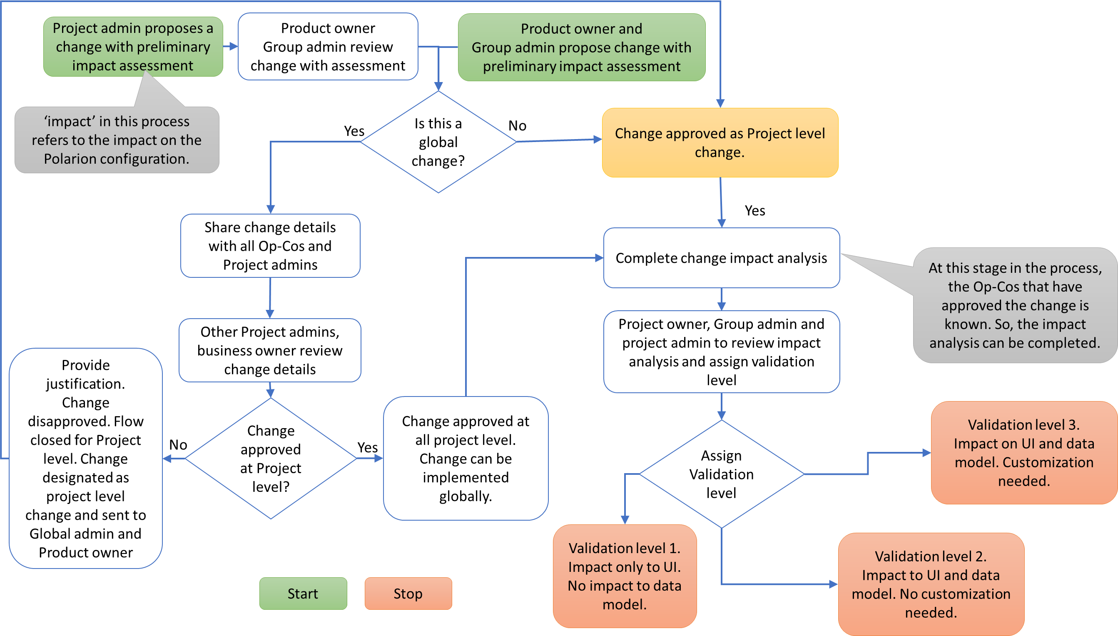
Change management- draft

Slide 40
Change implementation- draft
Global Admin
Op-Co Quality systems
Project Admin
Change approved at Project level and validation level assigned
Change approved at Global level and validation level assigned
Op Co update QMS processes/ procedures/ templates
Change requirements developed by Project admin
Change implemented by Global admin
Change UAT completed by Project admin
Change validated by Global admin
Op Co release procedures
Change released in Polarion system
Notes:
1. What are the required deliverables prior to release in Polarion system?
2. In which system would the change details be documented?
3. How can Vision team have access to the system where change details are stored? Is the access necessary? Can we show compliance by other means?

Slide 41
Procedure to be developed- draft
Procedures connecting to Franchise Governance procedure
Procedures integrating with QMS (and PLM) systems
Training procedures
NPS management procedure
Document change control procedure
Change management
Pre-approval of change
Training procedure
Change management procedure
Preliminary impact assessment
User training- How to use
Pre-approval of change
User training- How to request account
Change validation
PLM integration procedure
Export from Polarion
Upload to PLM
CSV validation
validation
Notes:
1. What are the required deliverables prior to release in Polarion system?
2. In which system would the change details be documented?
3. How can Vision team have access to the system where change details are stored? Is the access necessary? Can we show compliance by other means?

Slide 42
Back-ups

Slide 43
Polarion vs DOORS- General

Slide 44
FAQs
FAQs | Responses
Can the report be configured to display work items in draft mode? Approval in Polarion is a non-value add step. (or) Why does the report display only approved work items? | This is nudge for the user to check the data entry atleast once before exporting to pdf. As the user community matures, this non-value step can be removed.
Why is banner page (cover page) configured in live doc and data table is configured in LiveReport? (or) Why are there two separate files configured in Polarion for every deliverable? | For every deliverable, a decision must be made to either use LiveDoc or LiveReport for configuration. This decision is driven by the type of data in the deliverable. The data in the banner page (cover page) is free form text. This is fundamentally different from the type of data in the traceability table, like PRTM. Every piece of data in the traceability table must have a unique identifier and must be traced across multiple documents. LiveDoc is the best suited for deliverables with free form text. Customized LiveReports is the best suited for traceability tables.

Slide 45
Questions and follow-ups
Question/ Description | Status

